Slide 1
National Park Services
Group 4 - Andrew Knickman, Ayja Weems, Jorge Brito, Rojaleen Chhetry, Mary Martin, Greg Nikol, Sundeep Singh

Slide 2
Web Hosting & File Management
We used GoDaddy for webhosting as it was one of the cheaper options.
For file management we used FileZilla to upload all the files to the website.

Slide 3
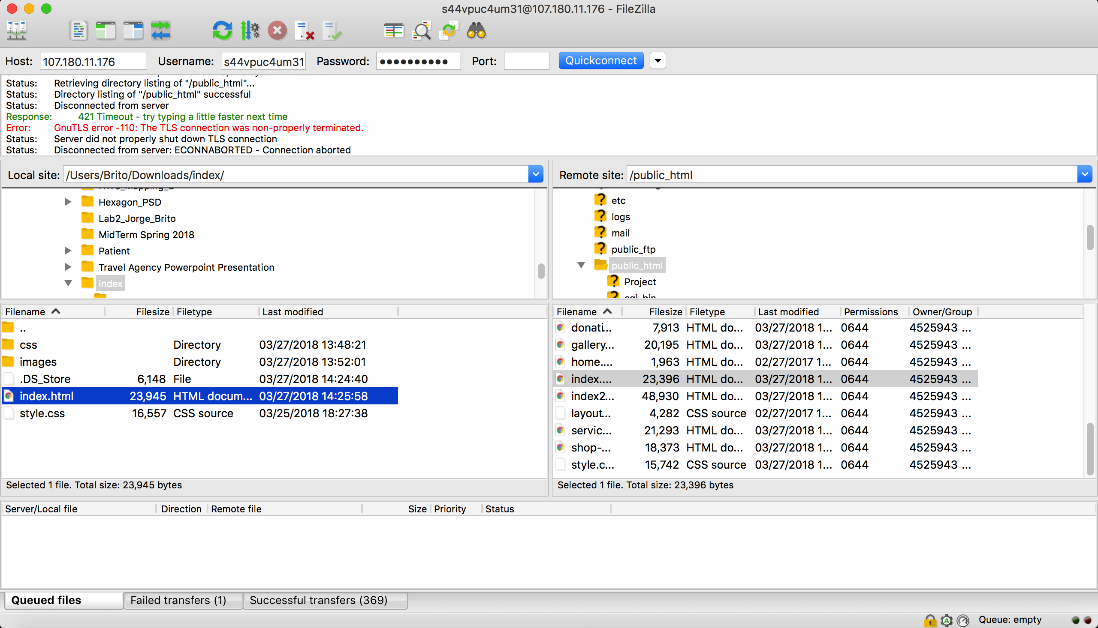

Slide 4
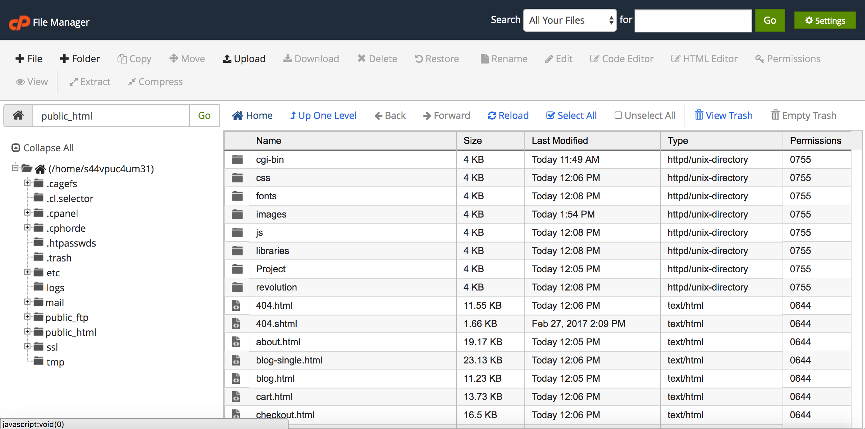

Slide 5
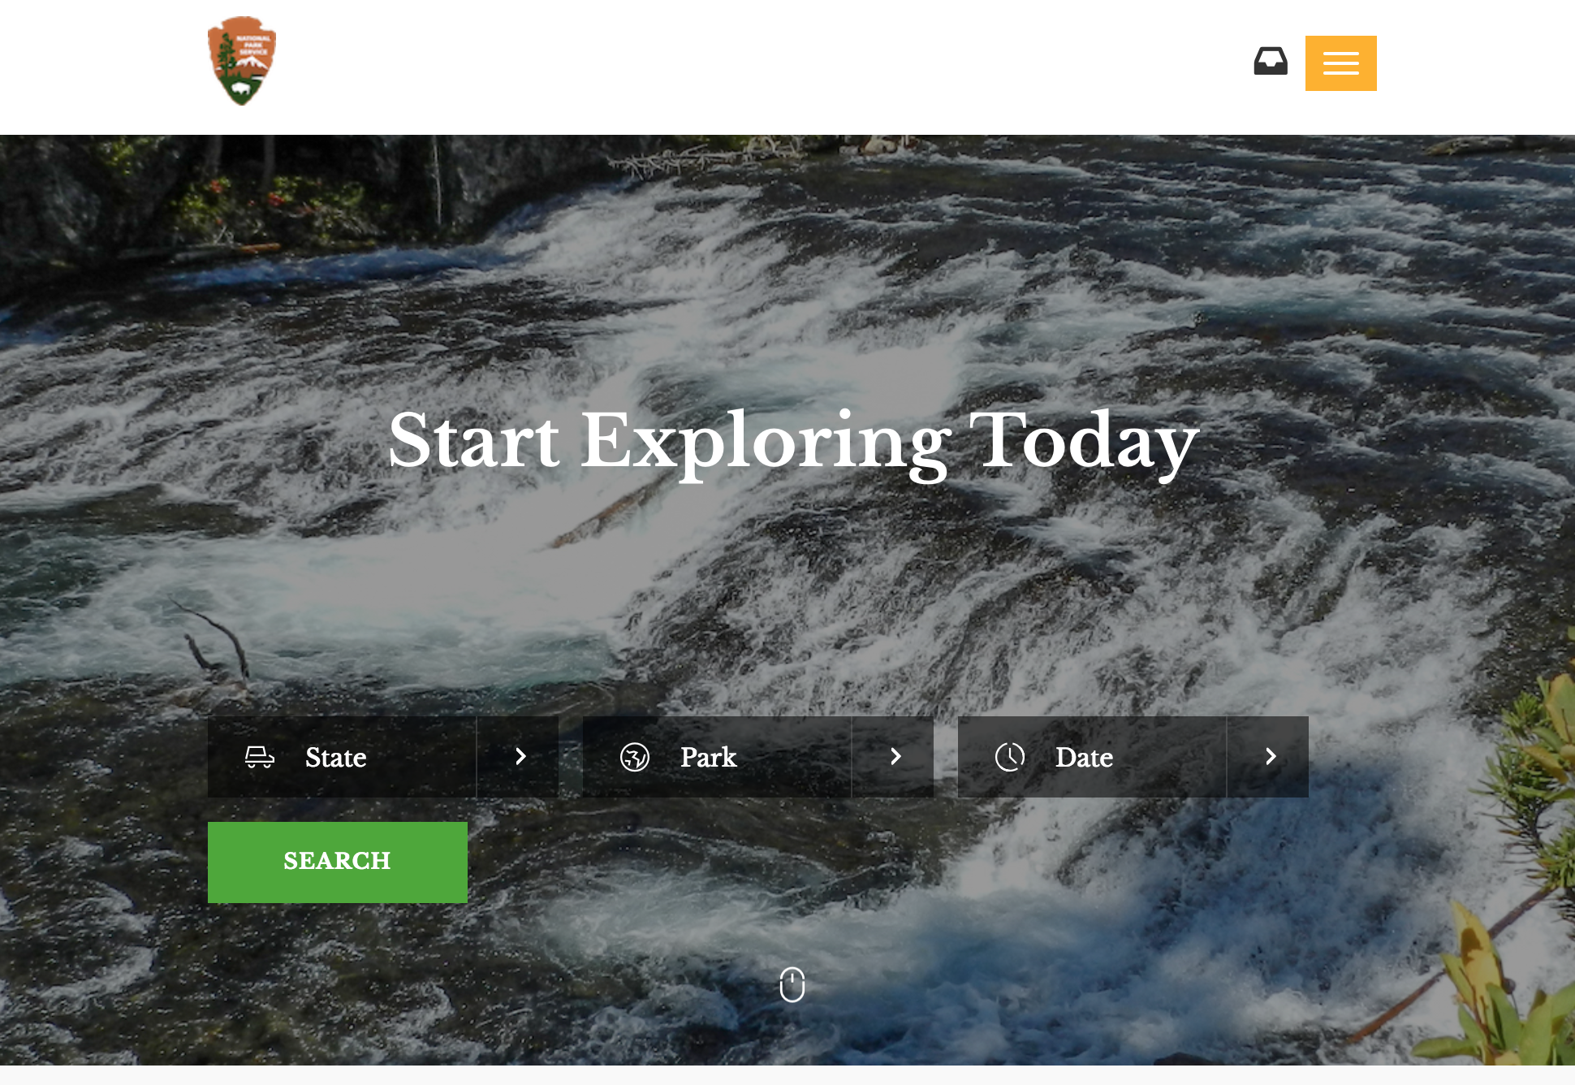
Homepage
Users are presented with the option to find passes directly from the homepage
This feature takes them directly to the ticketing page
Users are also able to navigate using a dropdown menu
When the site is fullscreen all navigation options are displayed

Slide 6
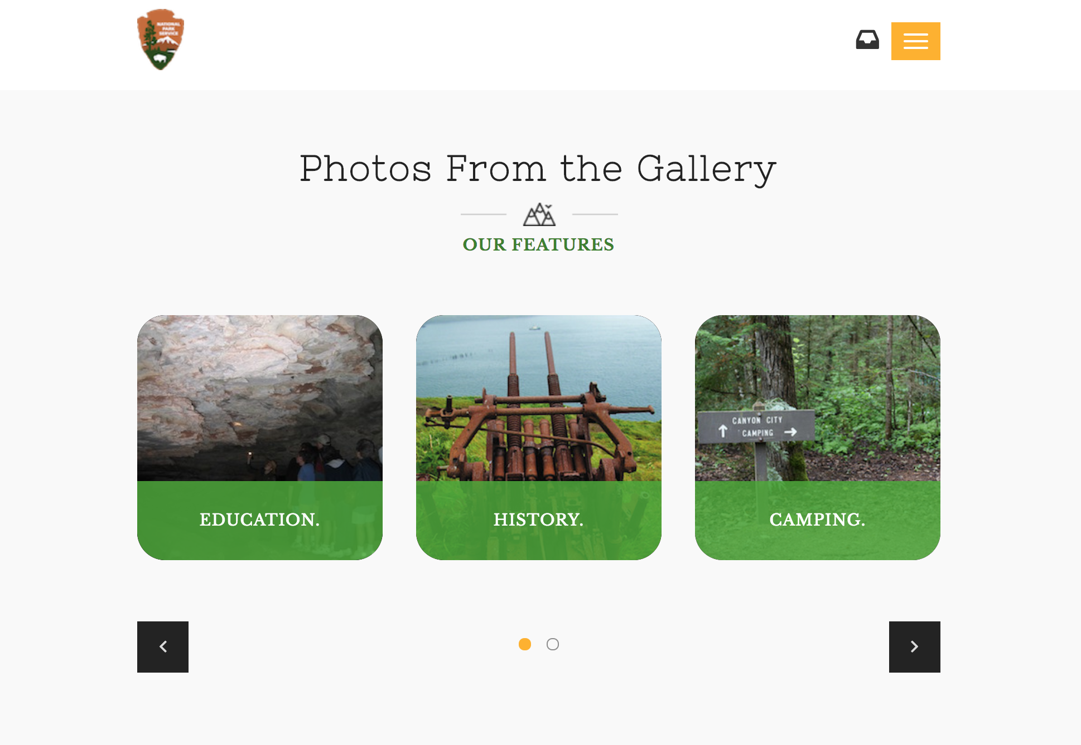
Homepage
Users are also able to view featured images from the gallery
These images encourage users to visit parks and learn more about where they were taken

Slide 7
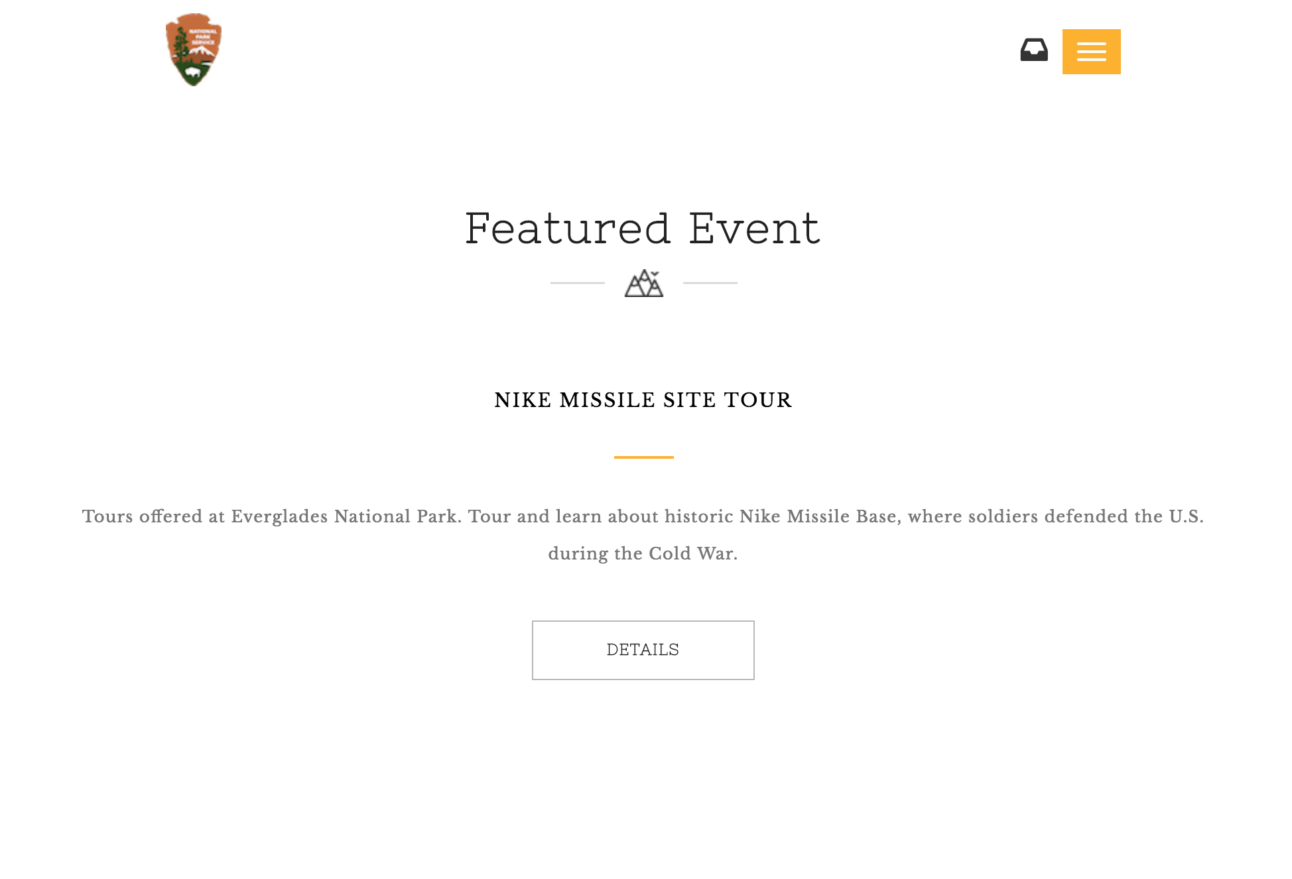
Homepage
Each week or month we have the ability to post a featured event
When users select “Details” they will be able to learn more about the event, such as dates and possible fees

Slide 8
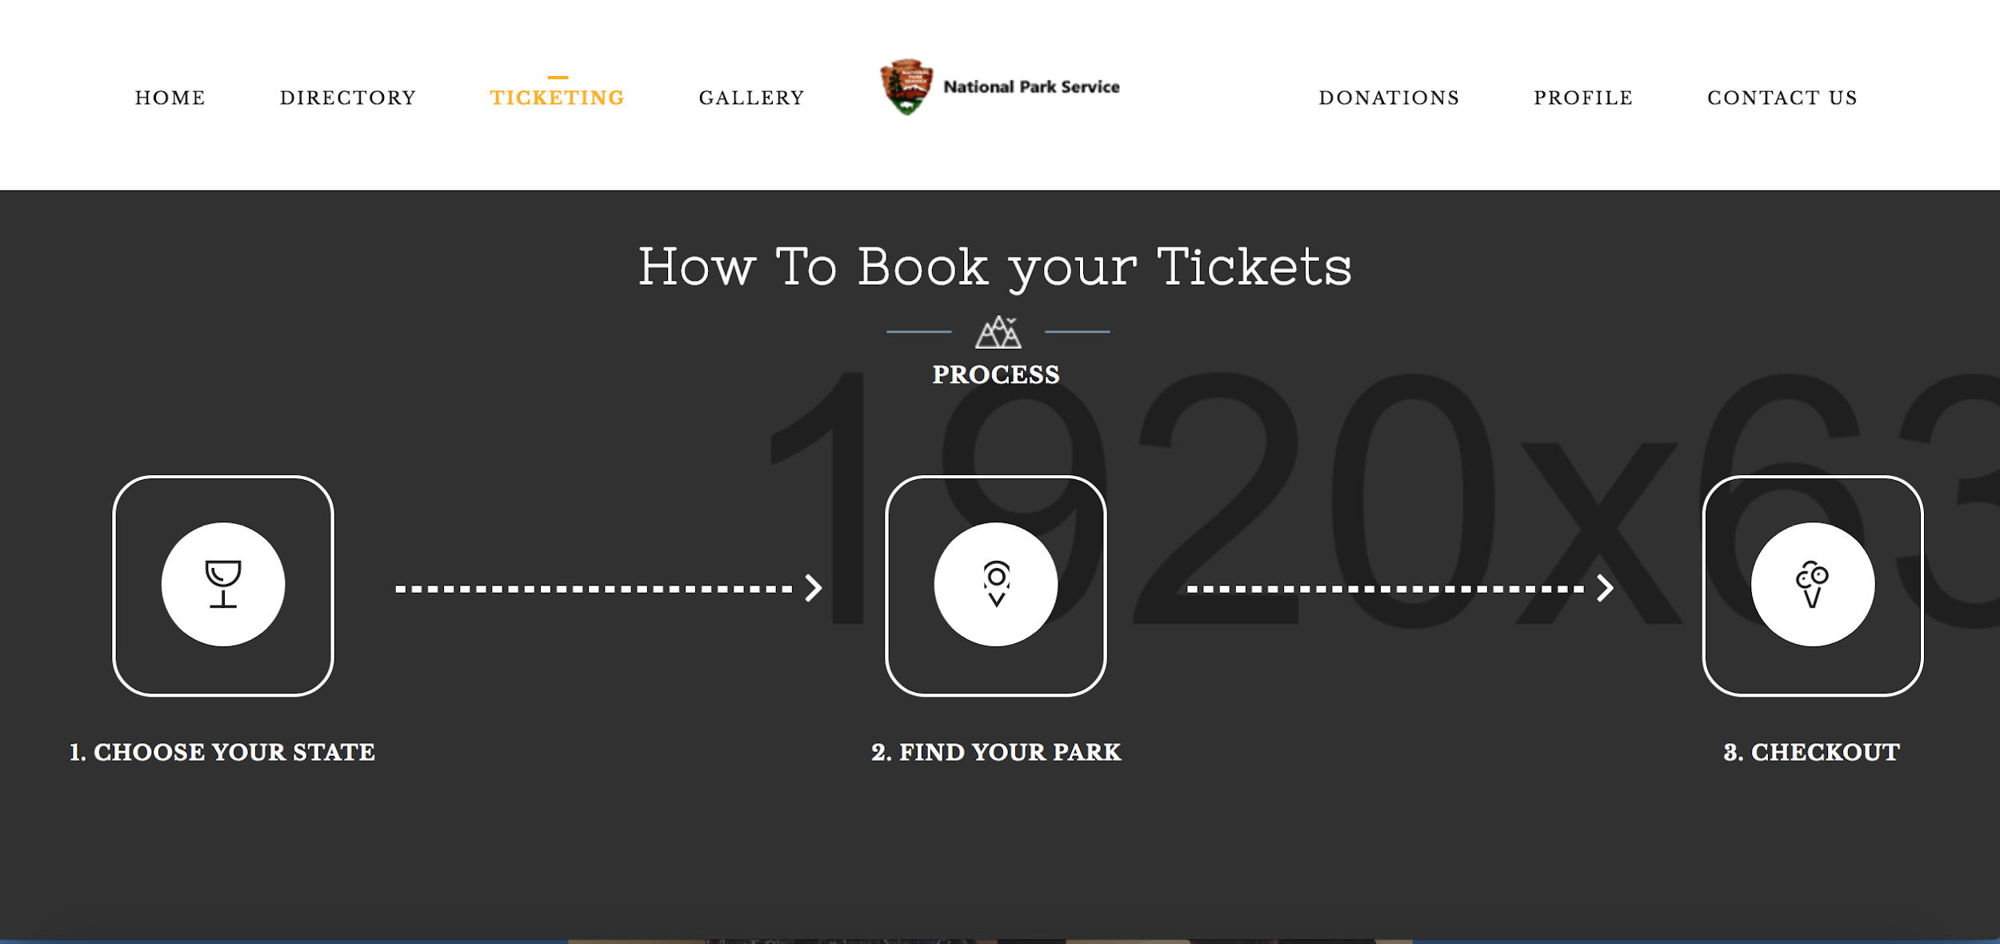
Ticketing
Users can go to the ticketing page and search their state.
After searching for the state find their park.
Choose the ticket(listed next to the park) and then checkout.

Slide 9
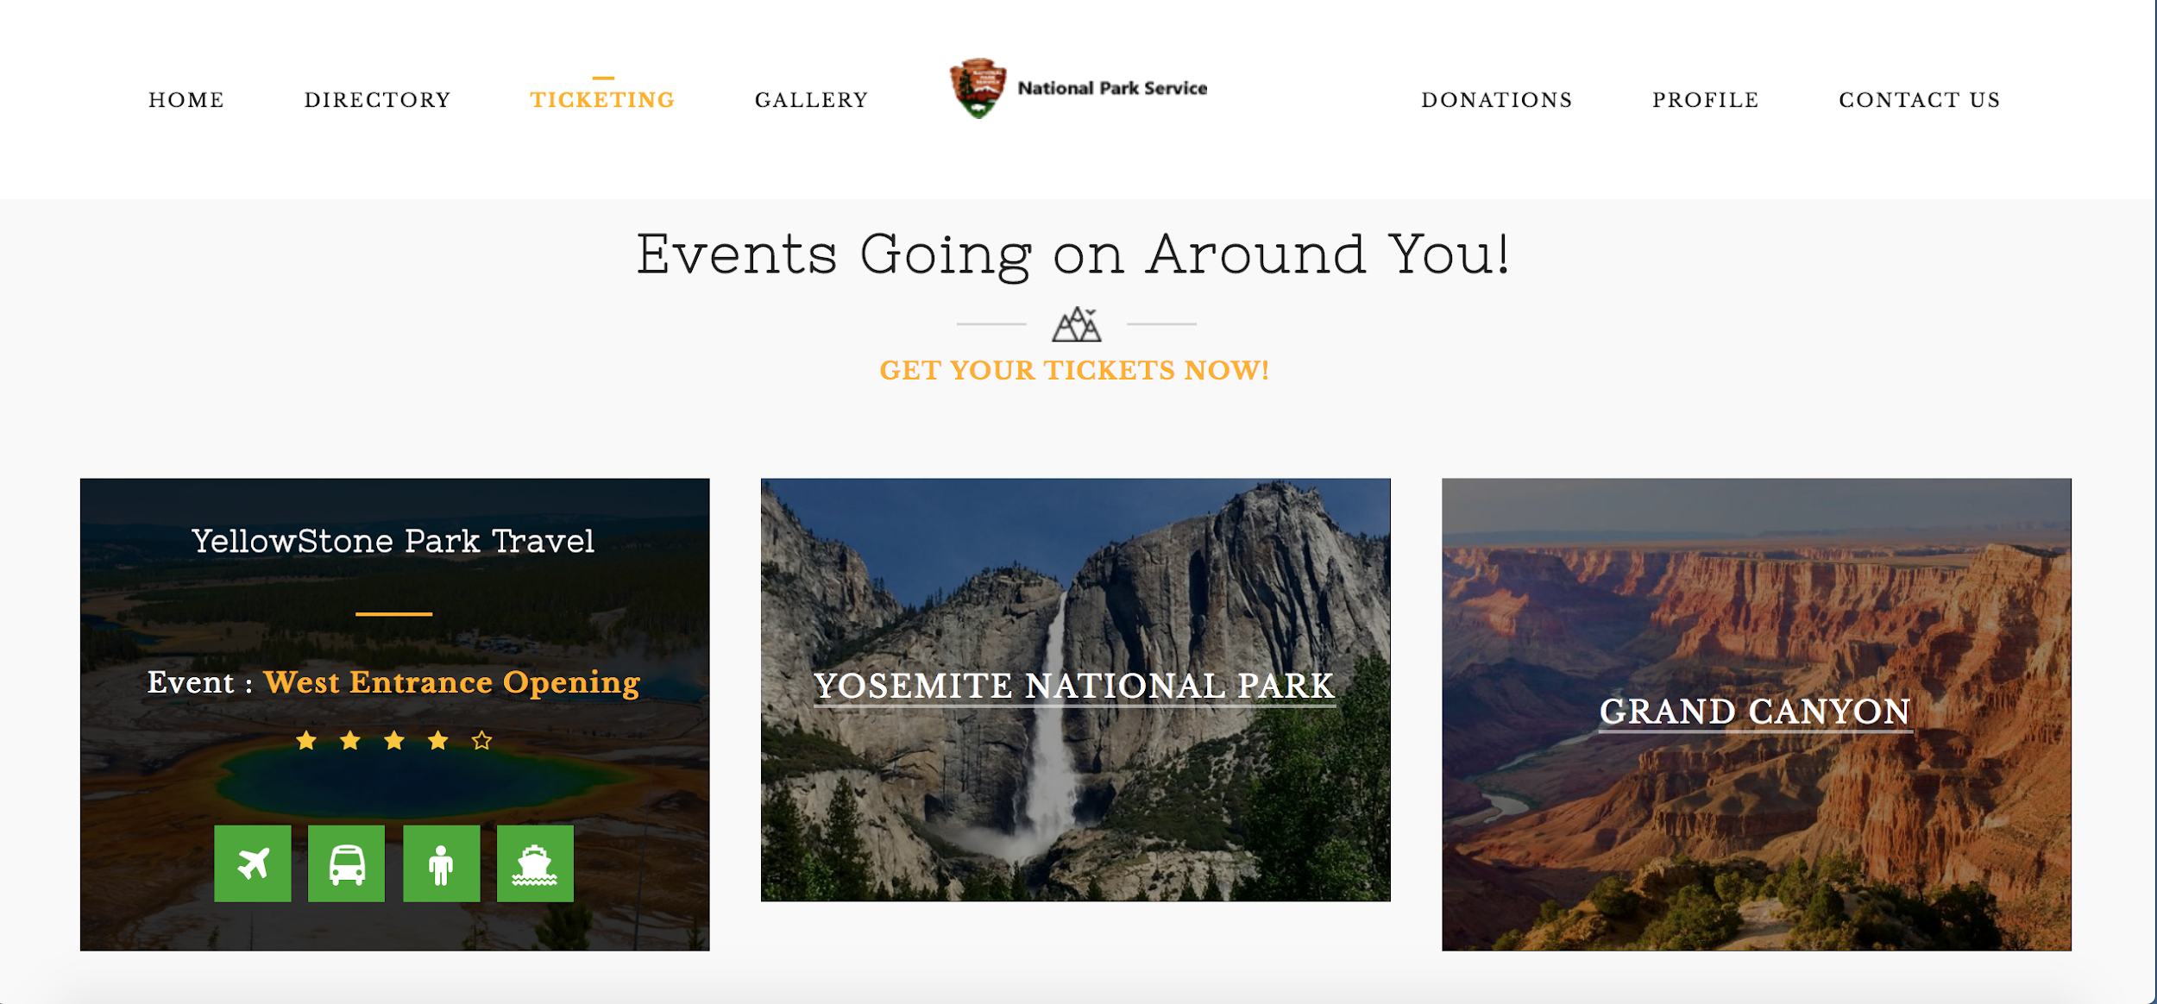
Ticketing
There will also be featured events that you can get direct tickets.
Give you the options to look for plane tickets, bus tickets etc.

Slide 10

Donations
User can go to the donation page and choose which donation tier that matches on how much they want to donate to the park.
Then the User can add it to their cart.

Slide 11
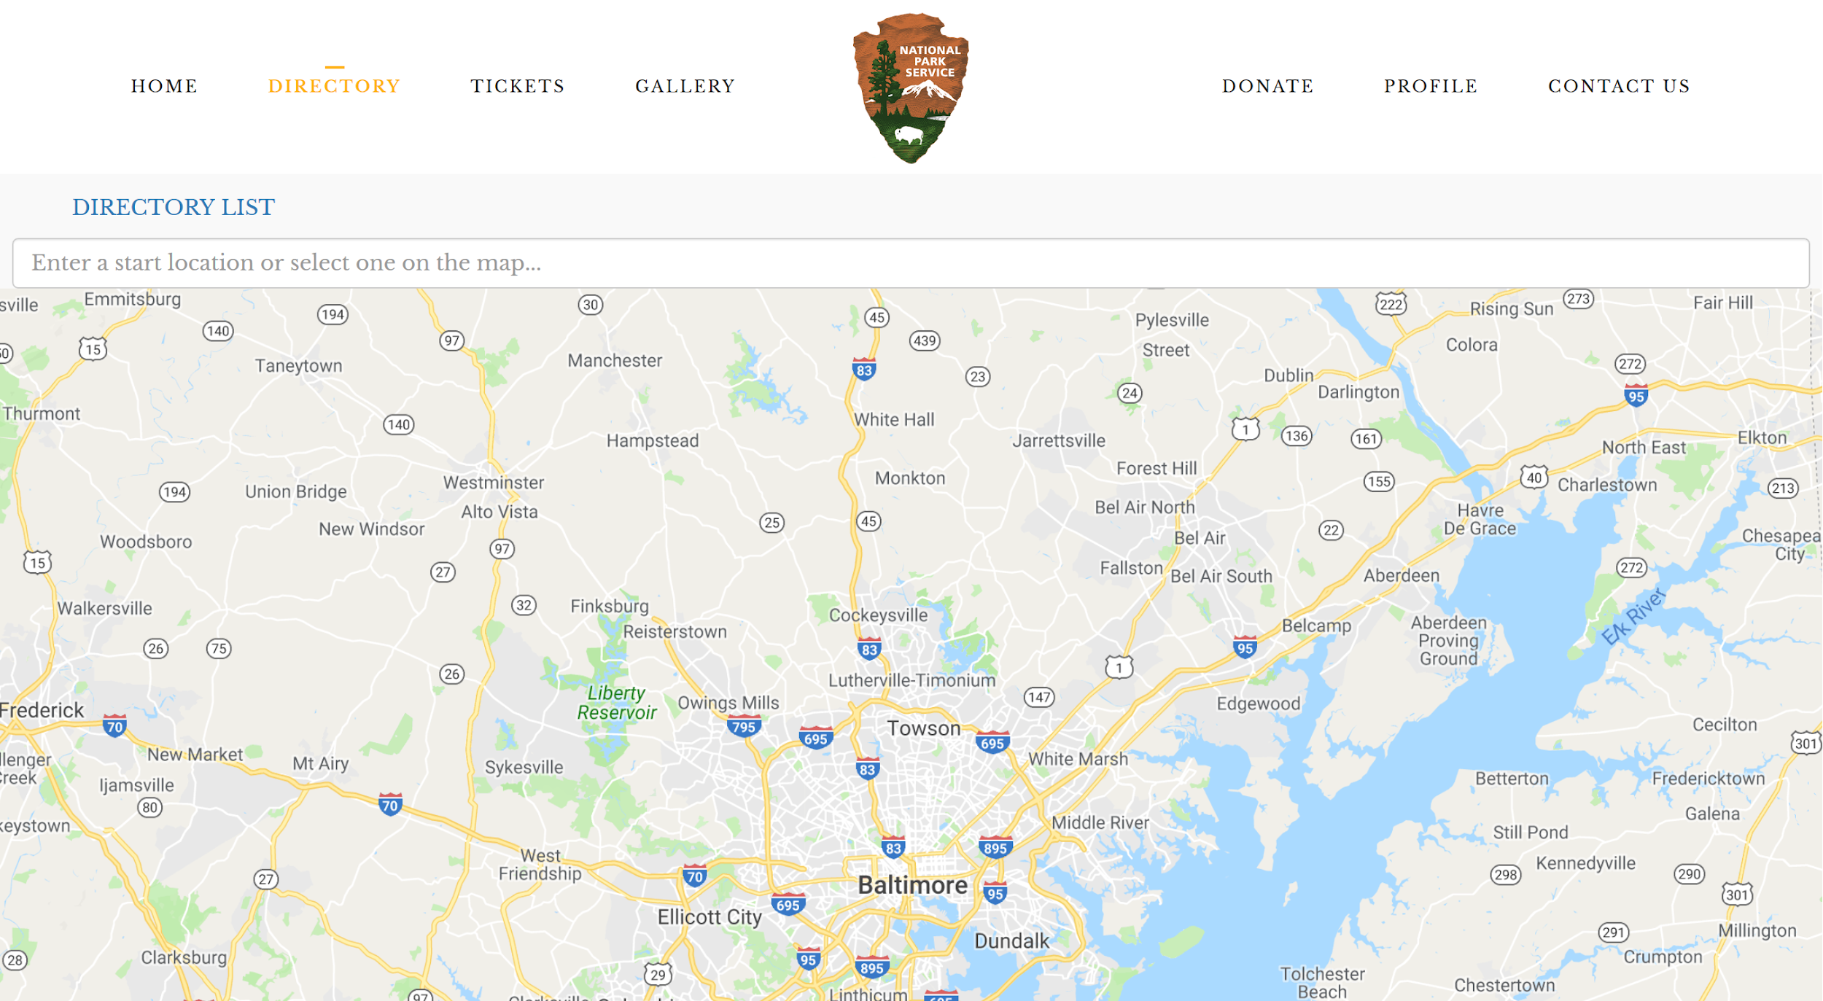
State Directory - Map
Users can use the search bar to enter a state/zip-code/city which will redirect to the park directory upon submission
Selecting a location on the map will trigger a confirmation prompt before redirecting to the park directory
“DIRECTORY LIST” is a temporary link for accessing the park directory

Slide 12
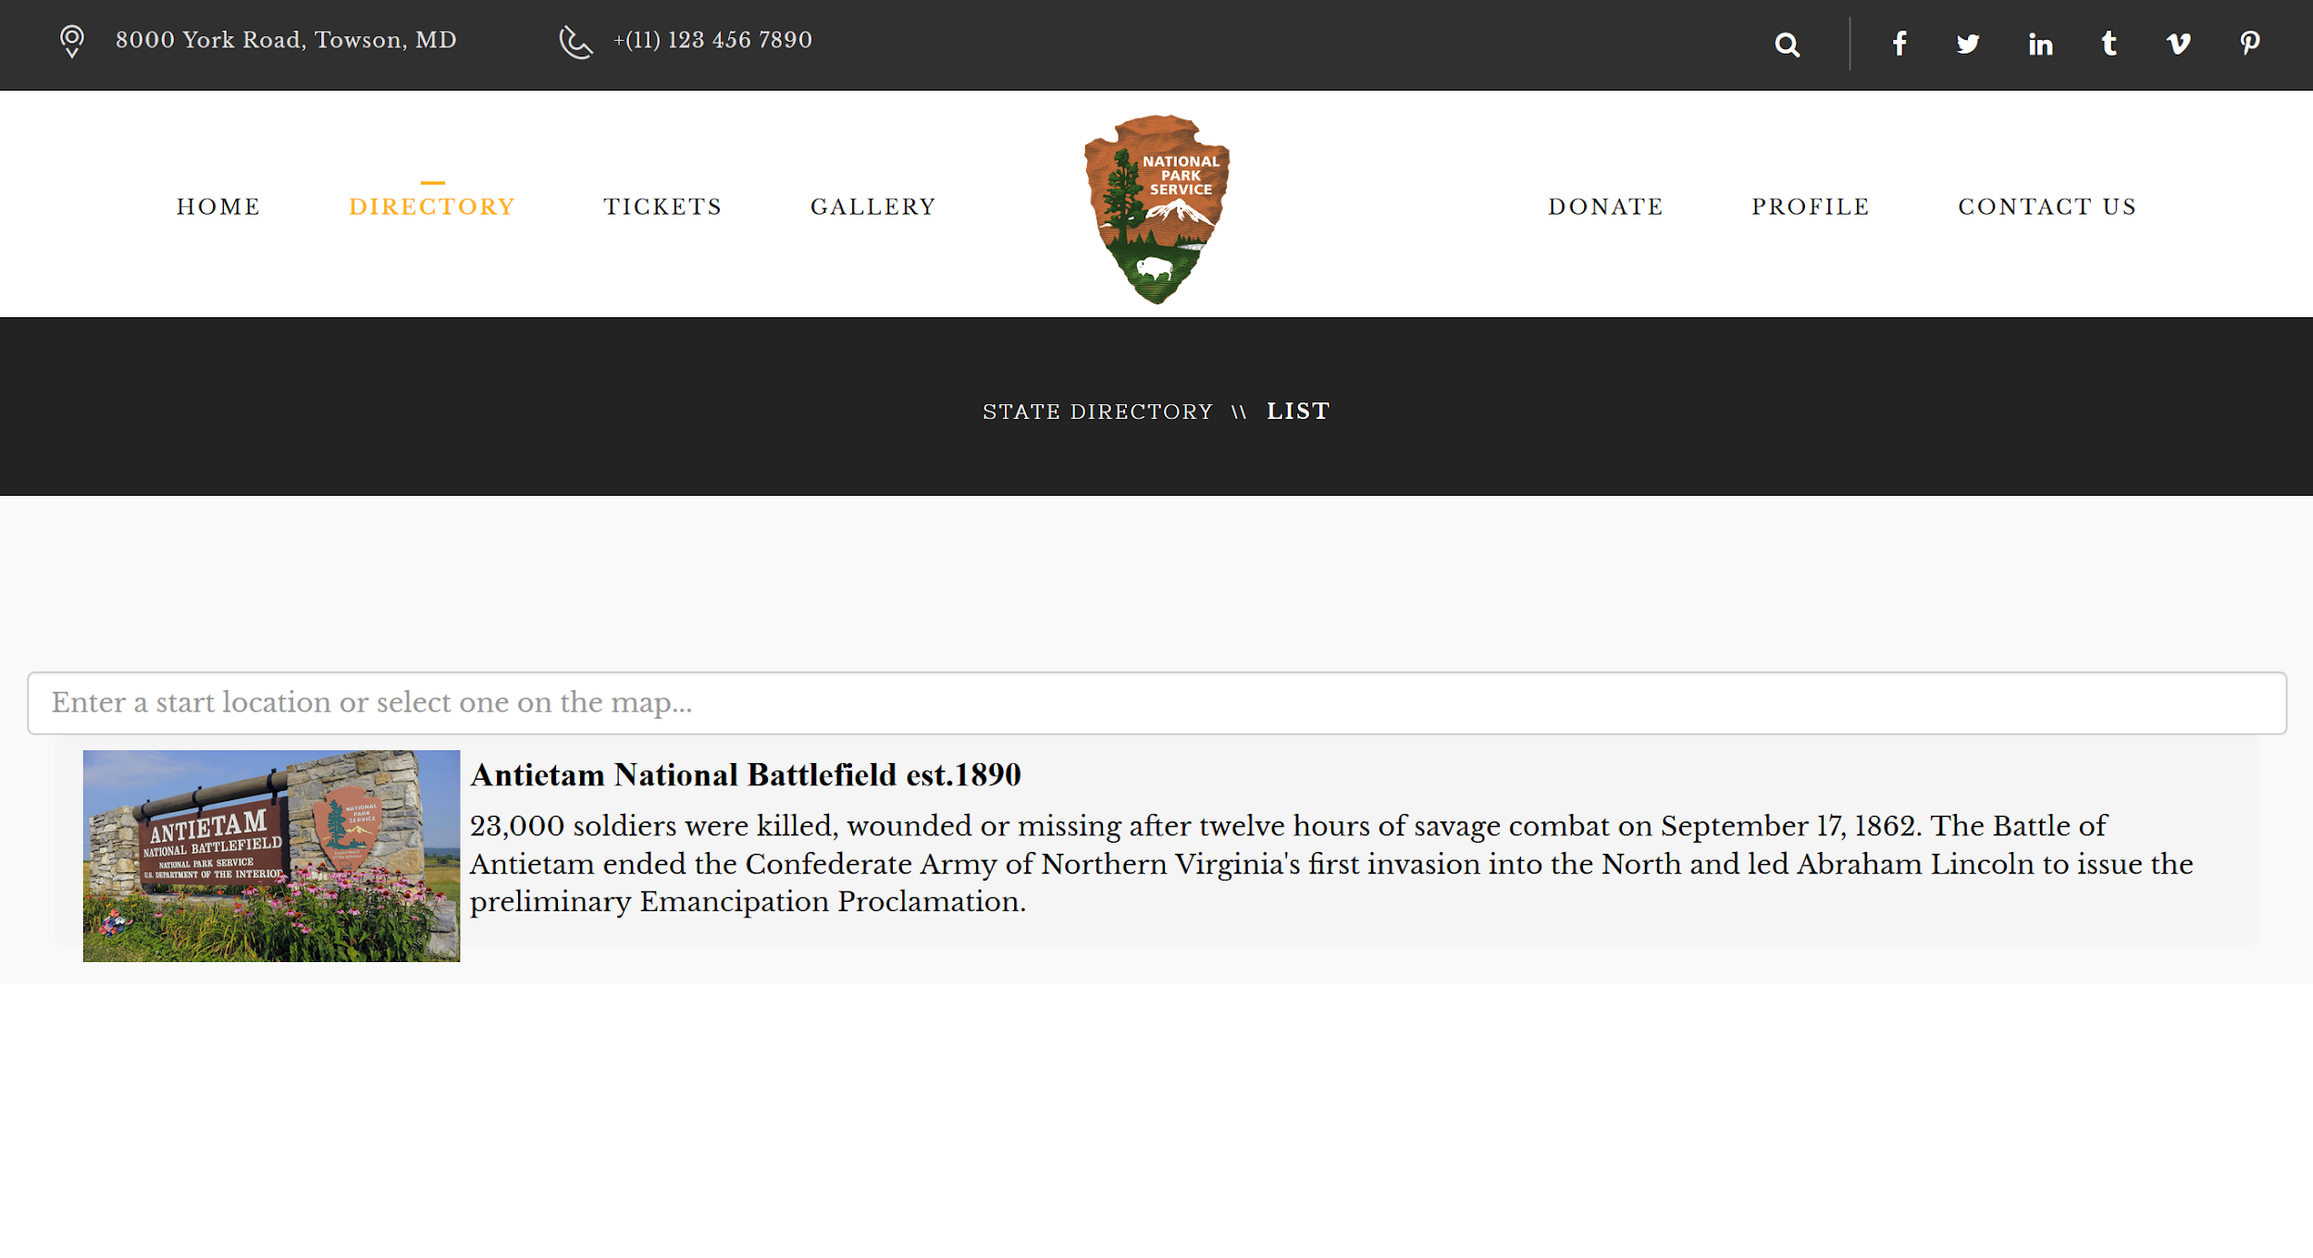
Park Directory - List
Users can enter a new state/zip-code/city using the search bar
A list of parks in the state entered will appear in alphabetical order if searched by state or distance order if searched by city/zip-code

Slide 13
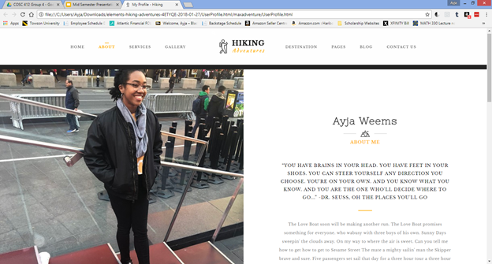
User Profile
--A gallery of photos submitted
-A list of donations made (with options for public or private donation listing)
-Game Accomplishments
-Profile Photo
-Interactive Campsite Gaming Experience

Slide 14
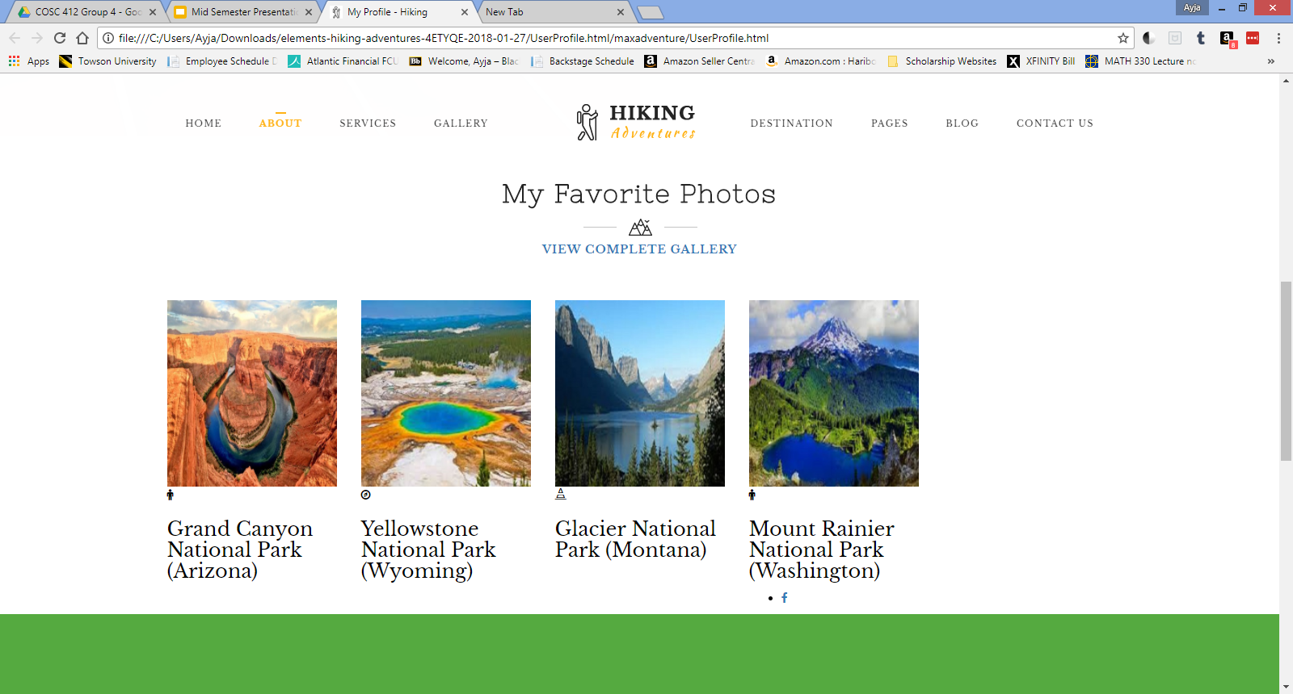
User Profile (Screenshot continued)

Slide 15
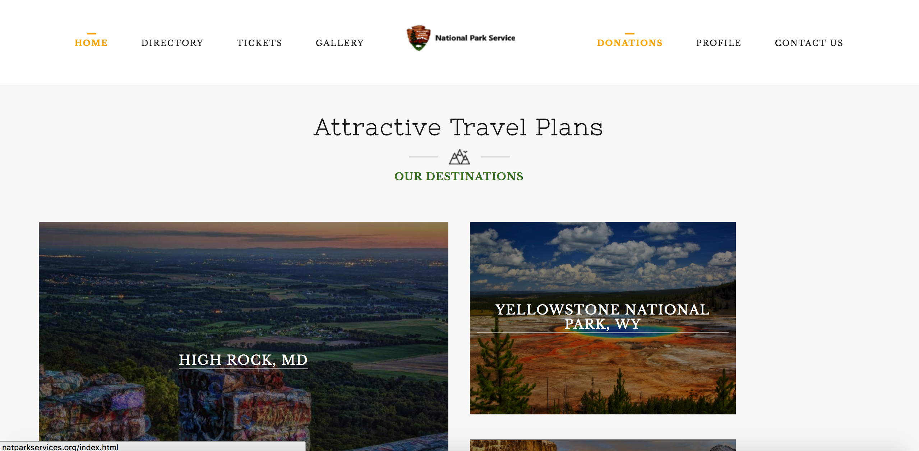
Gallery
Users will have a page of their gallery submissions
New users can also see the Top Posts from users that week.

